Slide 1
IPv4 ADDRESSES
An IPv4 address is a 32-bit address that uniquely and universally defines the connection of a device (for example, a computer or a router) to the Internet.

Slide 2
An IPv4 address is 32 bits long.

Slide 3
The IPv4 addresses are unique and universal.

Slide 4
The address space of IPv4 is 2³² or 4,294,967,296.

Slide 5
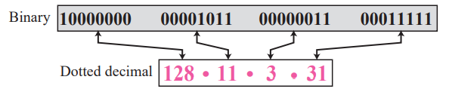
Dotted-decimal notation and binary notation for an IPv4 address
Binary notation (base 2),
Dotted-decimal notation (base 256),
Hexadecimal notation (base 16).
10000001 00001011 00001011 11101111
0X810B0BEF or 810B0BEF16

Slide 6
Example 1
Change the following IPv4 addresses from binary notation to dotted-decimal notation.
Solution
We replace each group of 8 bits with its equivalent decimal number (see Appendix B) and add dots for separation.

Slide 7
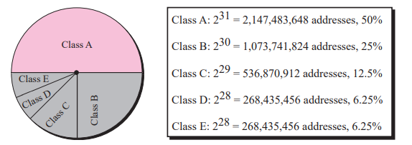
In Classful addressing, the address space is divided into five classes:
A, B, C, D, and E.

Slide 8
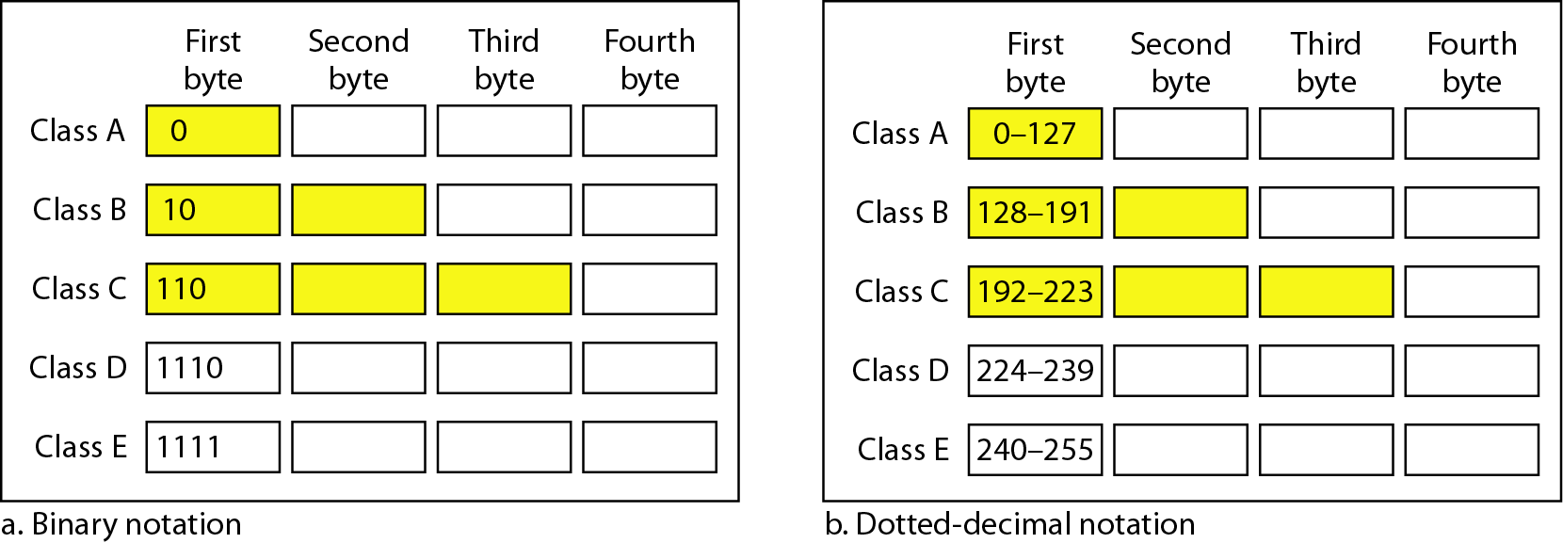
Finding the classes in binary and dotted-decimal notation

Slide 9
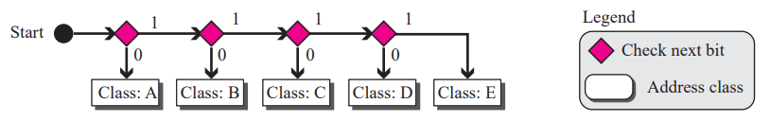
Finding the address class using continuous checking

Slide 10
Example 2
Find the class of each address.
a. 00000001 00001011 00001011 11101111
b. 11000001 10000011 00011011 11111111
c. 14.23.120.8
d. 252.5.15.111
Solution
a. The first bit is 0. This is a class A address.
b. The first 2 bits are 1; the third bit is 0. This is a class C address.
c. The first byte is 14; the class is A.
d. The first byte is 252; the class is E.

Slide 11
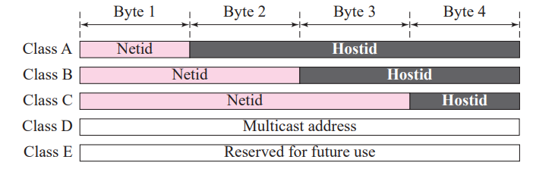
Netid and hostid
In classful addressing, an IP address in classes A, B, and C is divided into netid and hostid

Slide 12
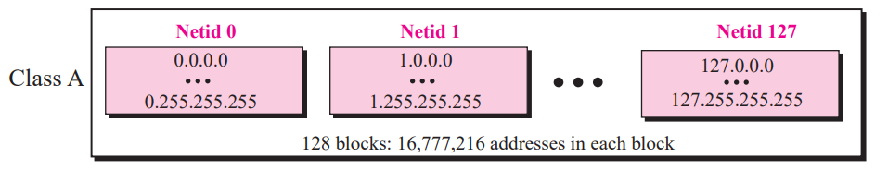
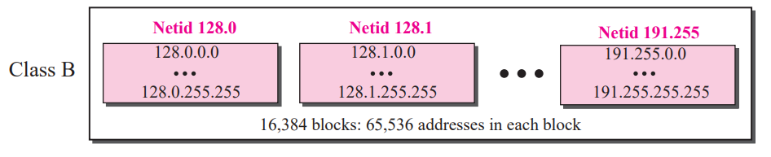
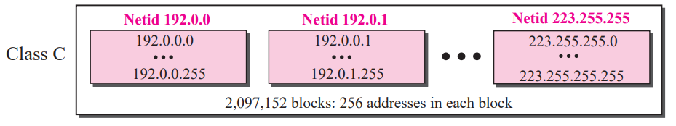
Classes and Blocks

Slide 13
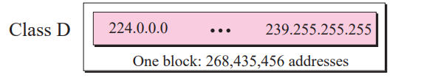
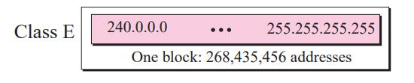

Slide 14
Millions of class A addresses are wasted.
Many class B addresses are wasted.
Not so many organizations are so small to have a class C block.
Class D addresses are made of one block, used for multicasting.
The only block of class E addresses was reserved for future purposes.

Slide 15
Number of blocks and block size in classful IPv4 addressing

Slide 16
In classful addressing, a large part of the available addresses were wasted.

Slide 17
Default masks for classful addressing

Slide 18
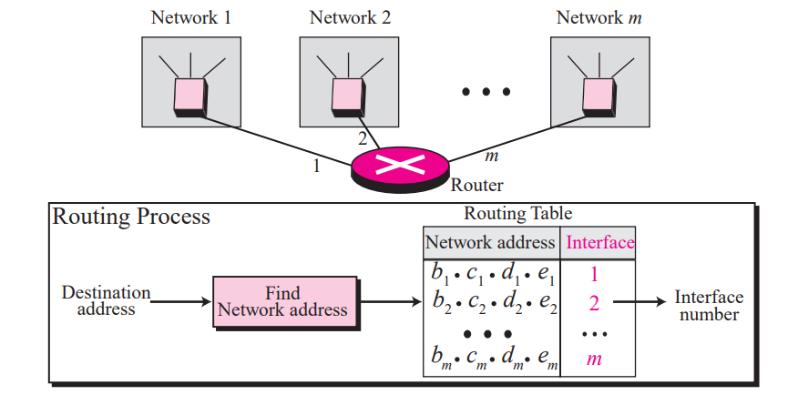
Network address

Slide 19
Default mask
A network mask or a default mask in classful addressing is a 32-bit number with n leftmost bits all set to 1s and (32 − n) rightmost bits all set to 0s.

Slide 20
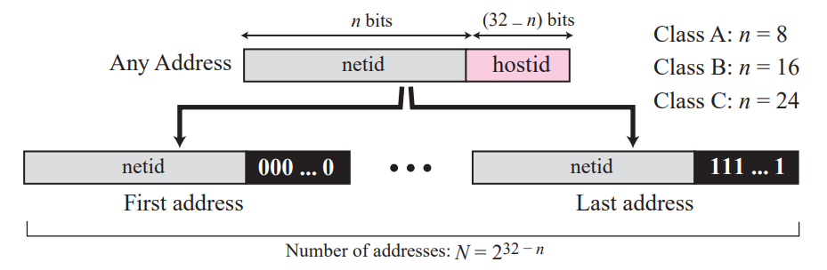
Information extraction in classful addressing

Slide 21
Example : An address in a block is given as 73.22.17.25. Find the number of addresses in the block, the first address, and the last address.
1.The number of addresses in this block is
N = 2^{32−n} = 2³²⁻⁸ = 2²⁴ = 16,777,216.
2.To find the first address, we keep the leftmost 8 bits and set the rightmost 24 bits all to 0s.
The first address is 73.0.0.0/8 in which 8 is the value of n.
3.To find the last address, we keep the leftmost 8 bits and set the rightmost 24 bits all to 1s. The last address is 73.255.255.255.

Slide 22
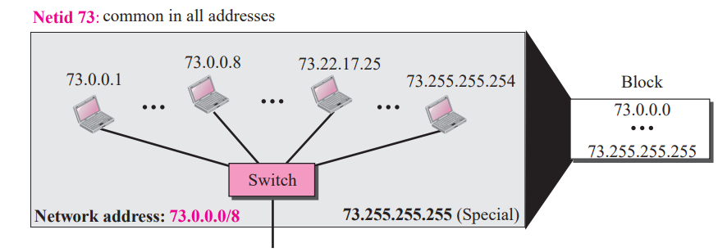

Slide 23
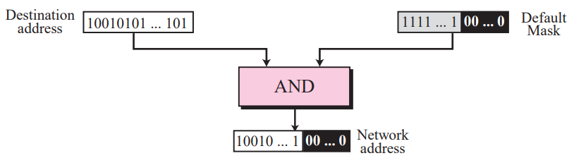
Finding a network address using the default mask

Slide 24
Example 2: An address in a block is given as 180.8.17.9. Find the number of addresses in the block, the first address, and the last address. Example3:An address in a block is given as 200.11.8.45. Find the number of addresses in the block, the first address, and the last address.

Slide 25
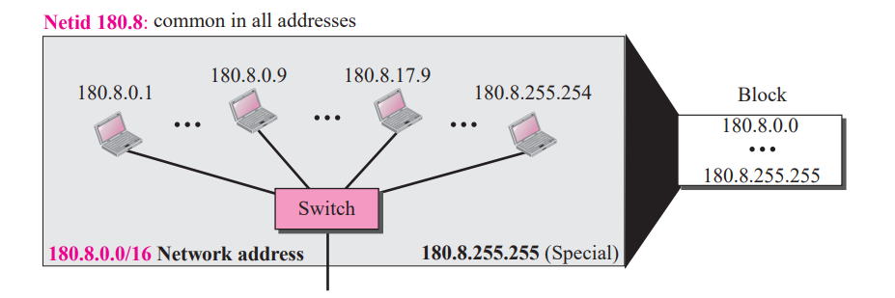
The number of addresses in this block is N = 2^{32−n} = 2¹⁶ = 65,536.

Slide 26
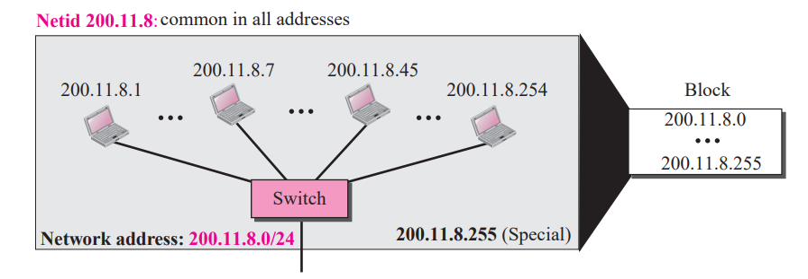

Slide 27
Classful addressing, which is almost obsolete, is replaced with classless addressing.

Slide 28
Classless Addressing
In IPv4 addressing, a block of addresses can be defined as
x.y.z.t /n
in which x.y.z.t defines one of the addresses and the /n defines the mask.

Slide 29
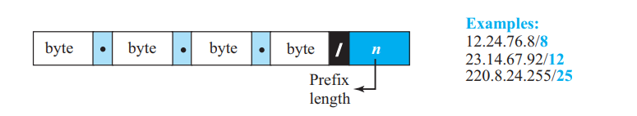
Slash notation (CIDR)
The number of addresses in the block is found as N = 2(32−n) .
To find the first address, we keep the n leftmost bits and set the (32 − n) rightmost bits all to 0s.
To find the last address, we keep the n leftmost bits and set the (32 − n) rightmost bits all to 1s.

Slide 30
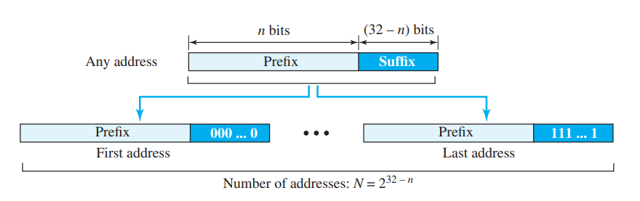

Slide 31
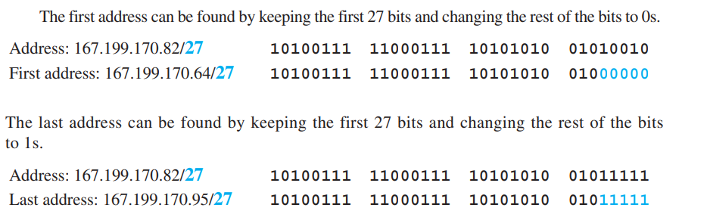
A classless address is given as 167.199.170.82/27. We can find the above three pieces of information
The number of addresses in the network is 2(32 − n) = 2(5) = 32 addresses.

Slide 32
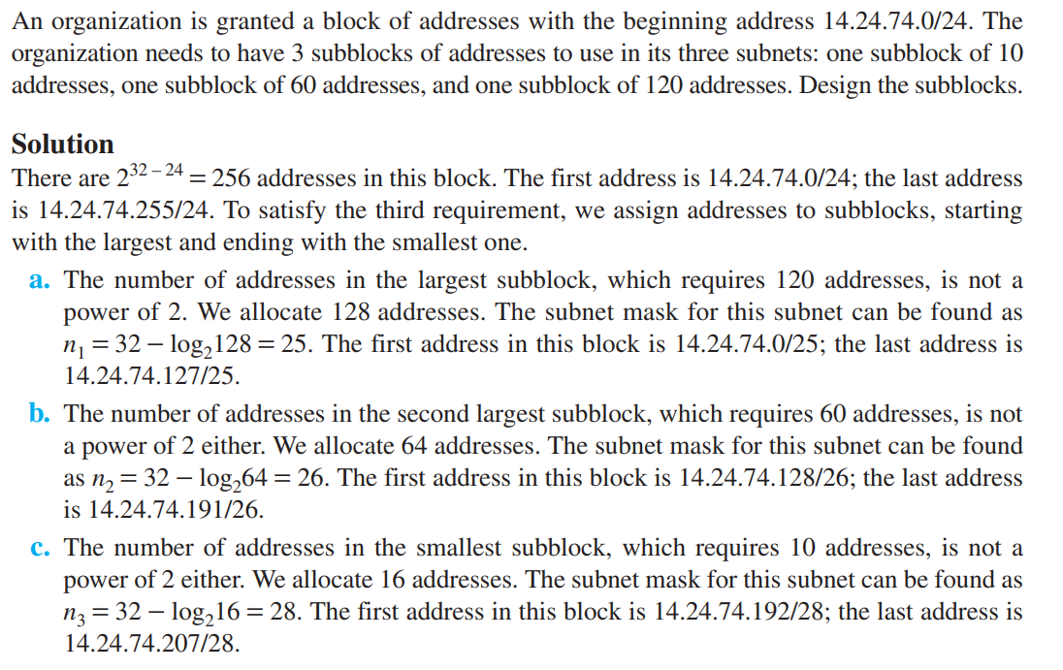

Slide 33
The first address in the block can be found by setting the rightmost 32 − n bits to 0s.

Slide 34
Example
A block of addresses is granted to a small organization. We know that one of the addresses is 205.16.37.39/28. What is the first address in the block?
Solution
The binary representation of the given address is
11001101 00010000 00100101 00100111
If we set 32−28 rightmost bits to 0, we get
11001101 00010000 00100101 0010000
or 205.16.37.32.

Slide 35
The last address in the block can be found by setting the rightmost 32 − n bits to 1s.

Slide 36
Example
Find the last address for the block .
Solution
The binary representation of the given address is
11001101 00010000 00100101 00100111
If we set 32 − 28 rightmost bits to 1, we get
11001101 00010000 00100101 00101111
or
205.16.37.47

Slide 37
The number of addresses in the block can be found by using the formula 2^{32−n}.

Slide 38
Example
Find the number of addresses
Solution
The value of n is 28, which means that number of addresses is 2 ³²⁻²⁸ or 16.

Slide 39
Example
Another way to find the first address, the last address, and the number of addresses is to represent the mask as a 32-bit binary (or 8-digit hexadecimal) number. This is particularly useful when we are writing a program to find these pieces of information. In 205.16.37.39/28 the /28 can be represented as
11111111 11111111 11111111 11110000
(twenty-eight 1s and four 0s).
Find
a. The first address
b. The last address
c. The number of addresses.

Slide 40
Example (continued)
Solution
a. The first address can be found by ANDing the given addresses with the mask. ANDing here is done bit by bit. The result of ANDing 2 bits is 1 if both bits are 1s; the result is 0 otherwise.

Slide 41
Example
b. The last address can be found by ORing the given addresses with the complement of the mask. ORing here is done bit by bit. The result of ORing 2 bits is 0 if both bits are 0s; the result is 1 otherwise. The complement of a number is found by changing each 1 to 0 and each 0 to 1.

Slide 42
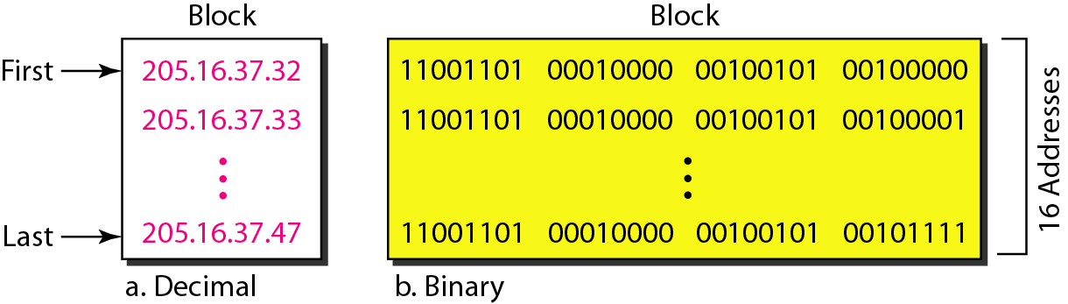
A network configuration for the block 205.16.37.32/28

Slide 43
The first address in a block is normally not assigned to any device; it is used as the network address that represents the organization to the rest of the world.

Slide 44
Each address in the block can be considered as a two-level hierarchical structure: the leftmost n bits (prefix) define the network;
the rightmost 32 − n bits define the host.

